Slide 1
Refactoring & Testing with the Visual Studio & C#
Halil İbrahim Kalkan
https://github.com/hikalkan/presentations
(https://bit.ly/2OSYGze)

Slide 2
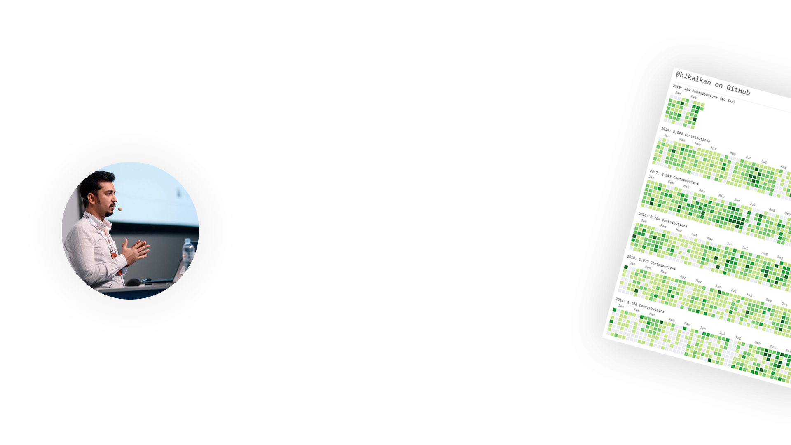

ABOUT ME Halil İbrahim Kalkan
Co-Founder of
Web: halilibrahimkalkan.com
Github: @hikalkan
Twitter: @hibrahimkalkan

Slide 3
Writing Code for Humans!
“Any fool can write code that a computer can understand. Good programmers write code that humans can understand.”
Martin Fowler

Slide 4

Writing “Simple” Code!
“Playing football is very simple, but playing simple football is the hardest thing there is.”
Johan Cruyff
Writing code is very simple, but writing simple code is the hardest thing there is!
???

Slide 5
Object Oriented Programming
Interfaces
Classes
Abstraction
OOP
Information Hiding
Inheritance
Encapsulation
Polymorphism

Slide 6
SOLID Principles
S: Single Responsibility Principle
O: Open Closed Principle
L: Liskov Substitution Principle
I: Interface Segregation Principle
D: Dependency Inversion Principle

Slide 7
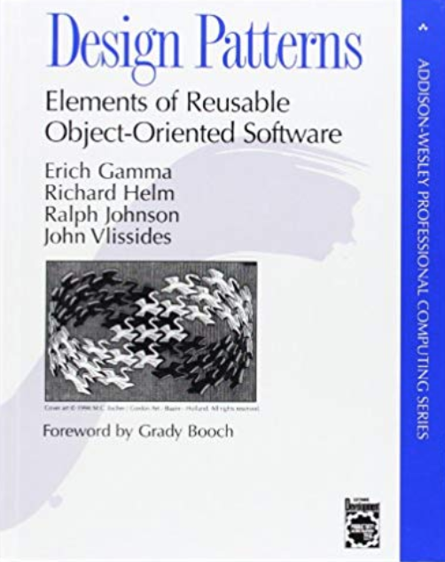
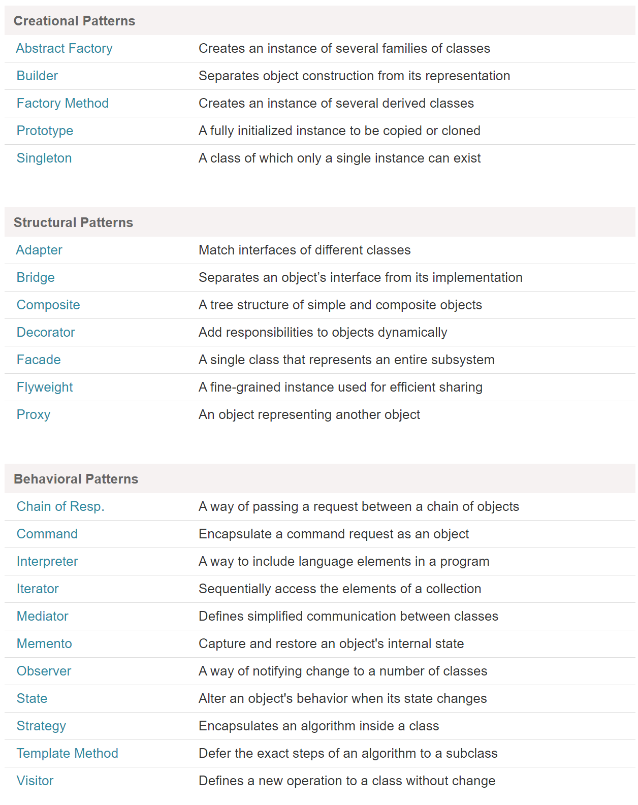
(GoF) Design Patterns
https://www.dofactory.com/net/design-patterns

Slide 8
Refactoring
“When you find you have to add a feature to a program, and the program's code is not structured in a convenient way to add the feature, first refactor the program to make it easy to add the feature, then add the feature.”
Martin Fowler

Slide 9
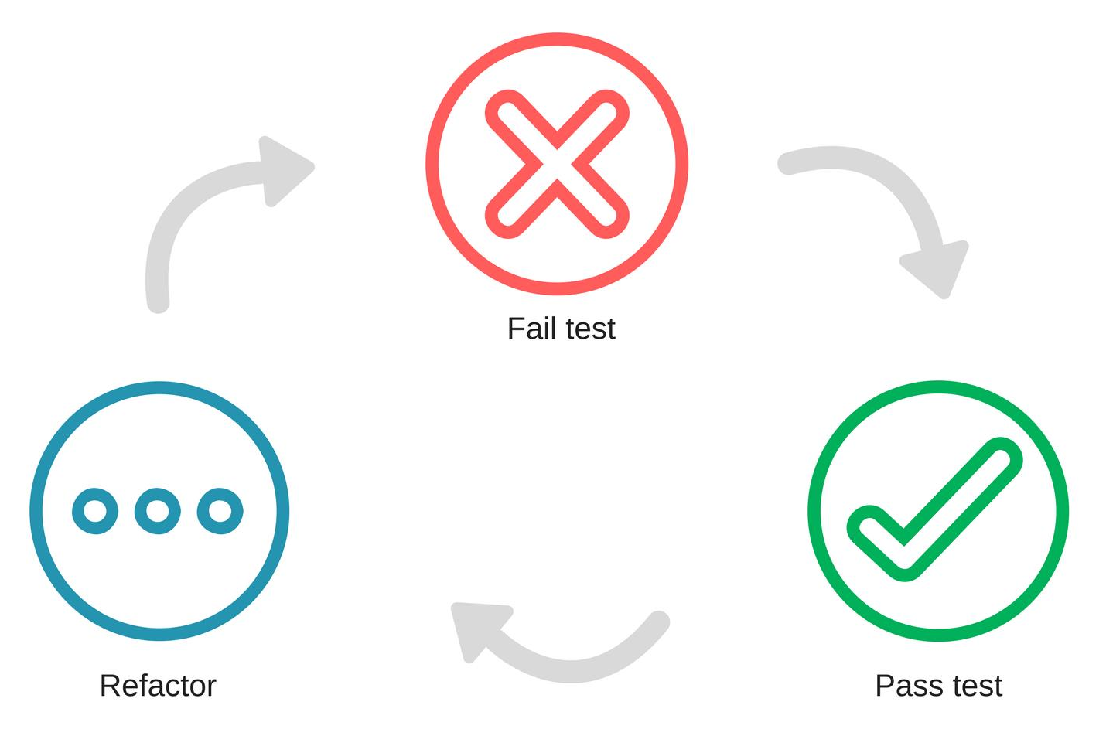
Refactoring & Test Driven Development

Slide 10

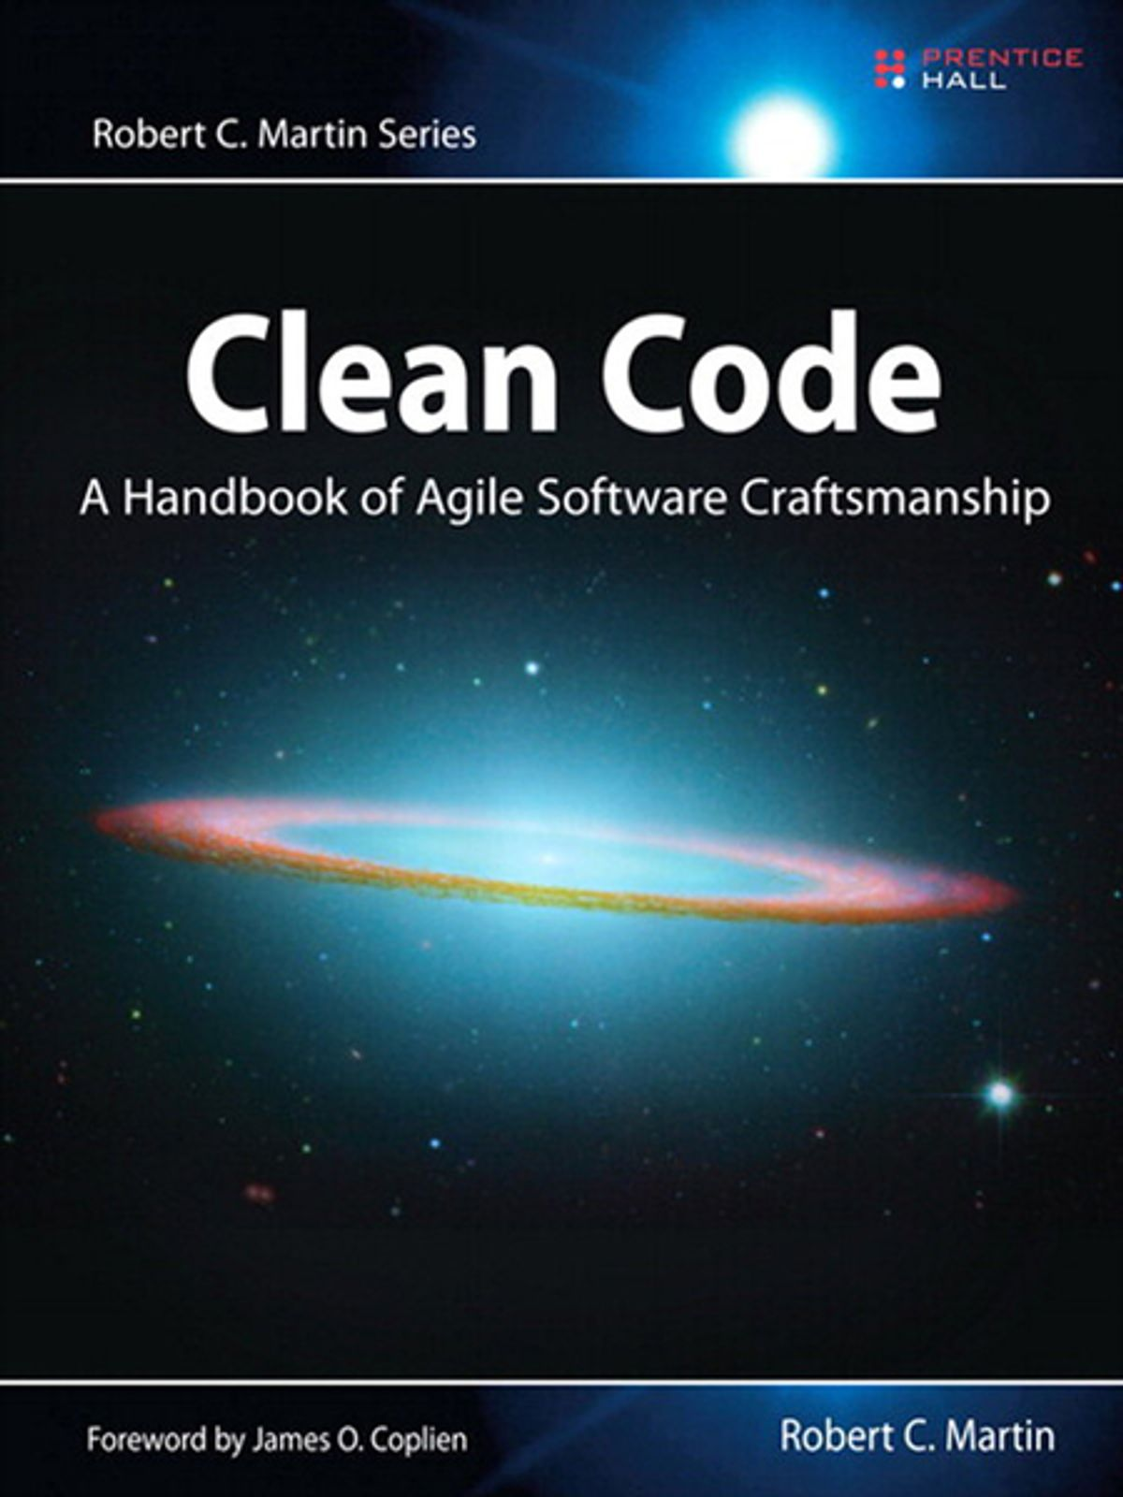
The Ultimate Books!

Slide 11
Refactoring & Testing with the Visual Studio & C#
Show me code!

Slide 12
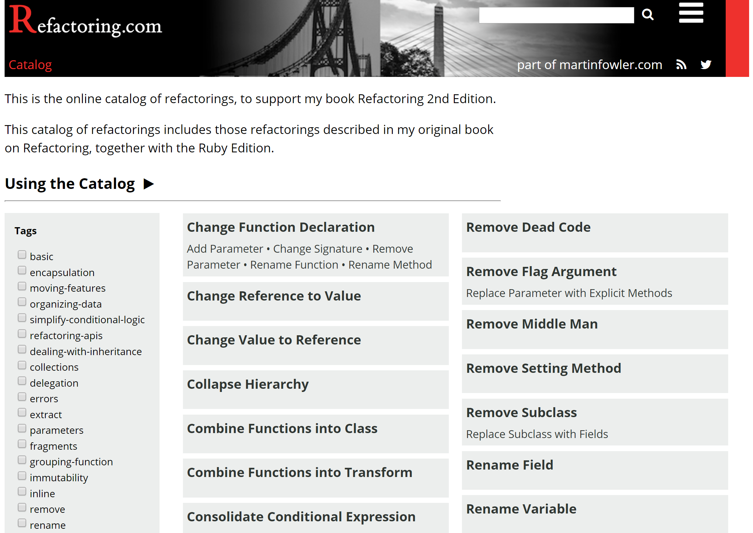
https://refactoring.com/catalog/

Slide 13
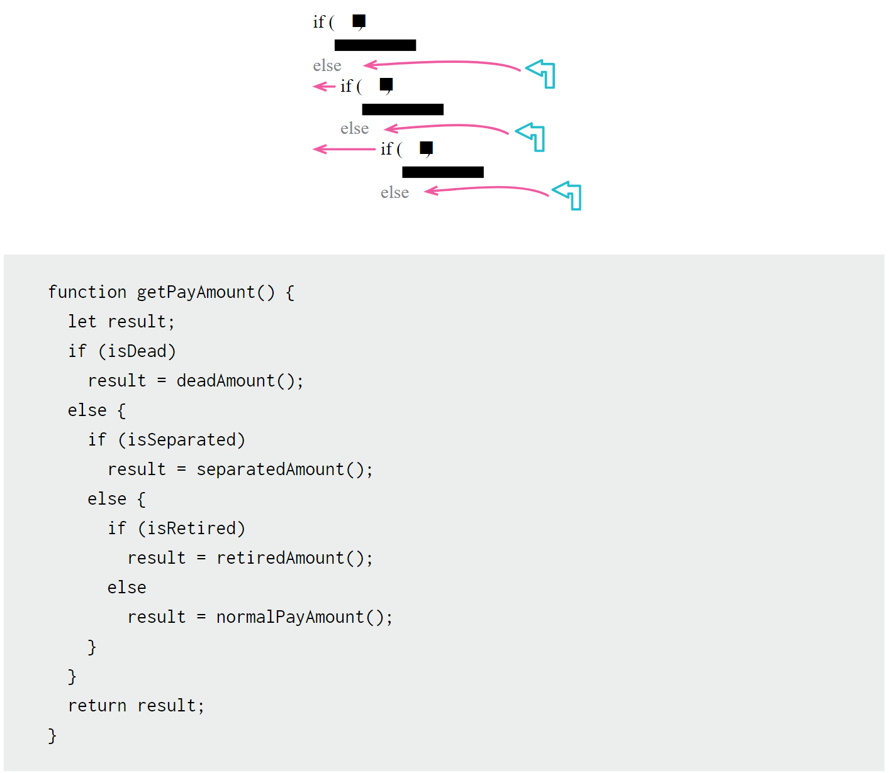
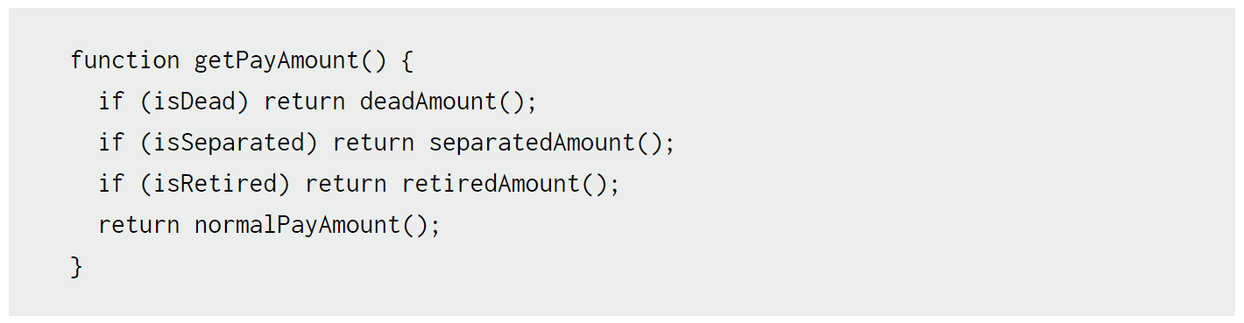
https://refactoring.com/catalog/
Replace Nested Conditional with Guard Clauses

Slide 14
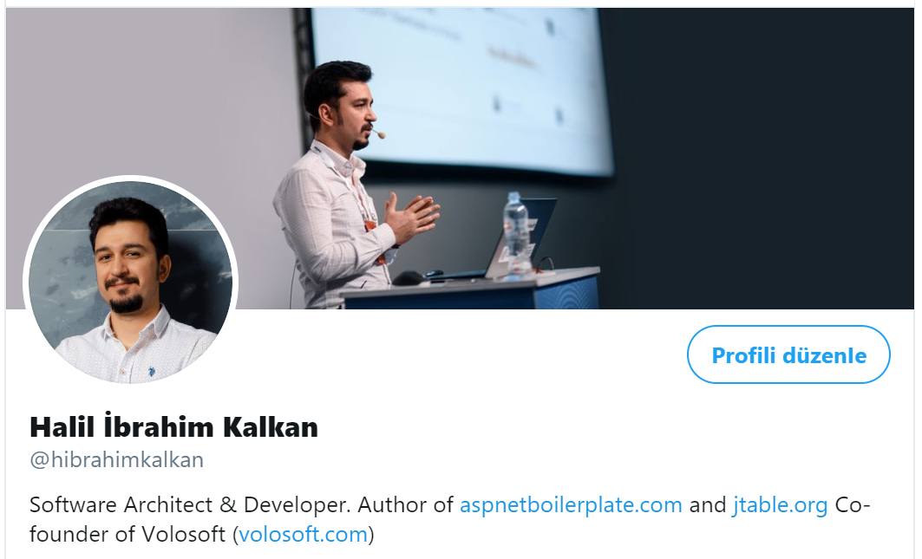
Thanks!
Halil İbrahim Kalkan
http://halilibrahimkalkan.com
GitHub @hikalkan
Twitter @hibrahimkalkan
https://volosoft.com
Presentation: https://github.com/hikalkan/presentations

